Slide 1
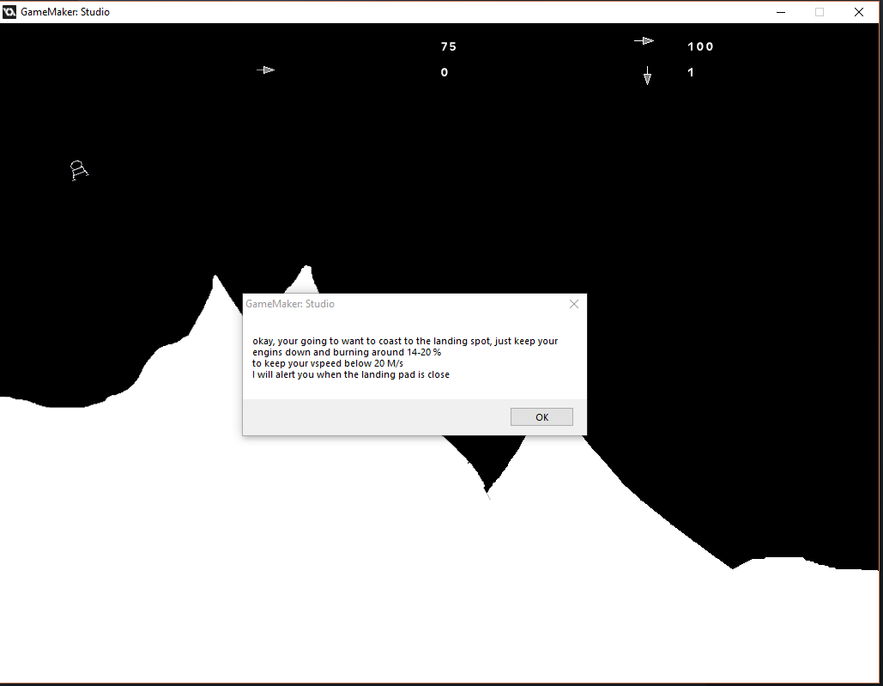
Advanced Game Design Final Project Slide # 1
First level opening Message
Pop up messages like this bombarded the play as soon as the level loaded in both the Tutorial and First Level
The messages can be skipped by simply hitting enter
Messages are wordy and mix together story and game instructions

Slide 2
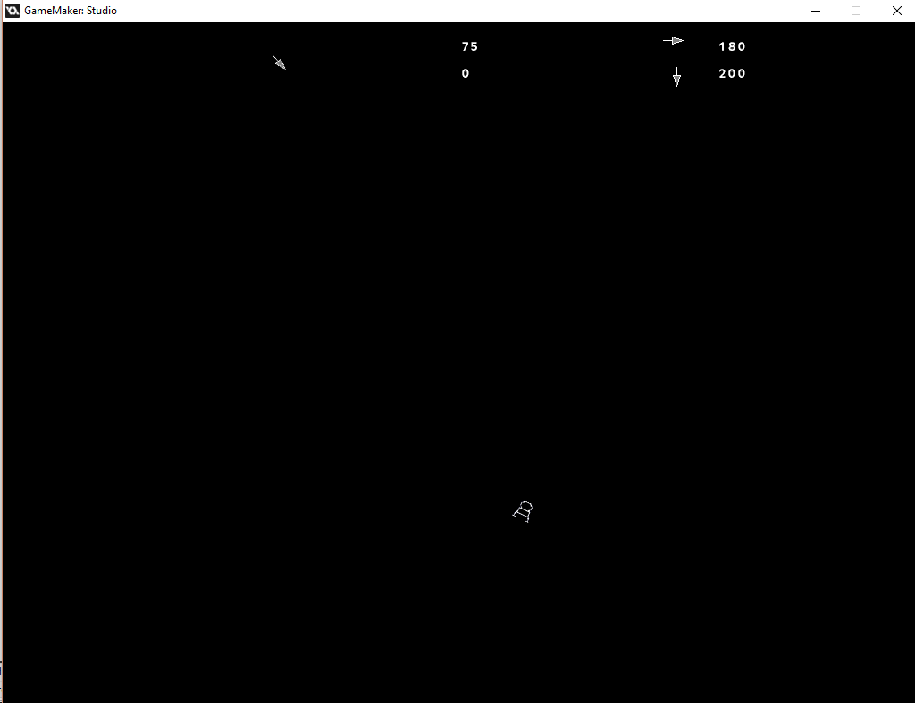
Advanced Game Design Final Project Slide # 2
Tutorial Capture
Blank Screen
Un-labeled indicators (Left most is current direction of travel)
Zero reference in the scene for speed or direction
Small ‘character’ model (refer to middle lower third of capture)

Slide 3
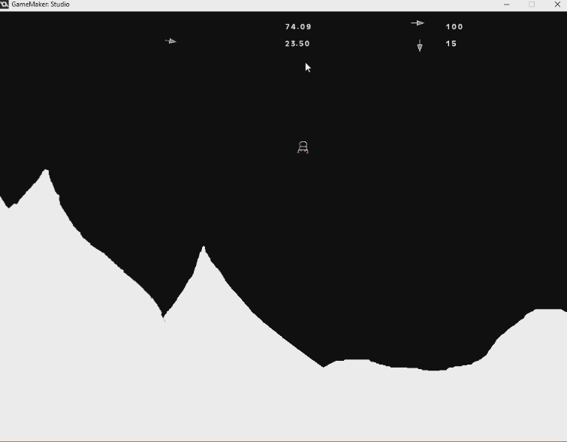
Advanced Game Design Final Project Slide # 3
H.U.D. Pre Re-Design
Small Un-labeled indicators
No framing for indicators
Very empty screen (Semi by design)

Slide 4
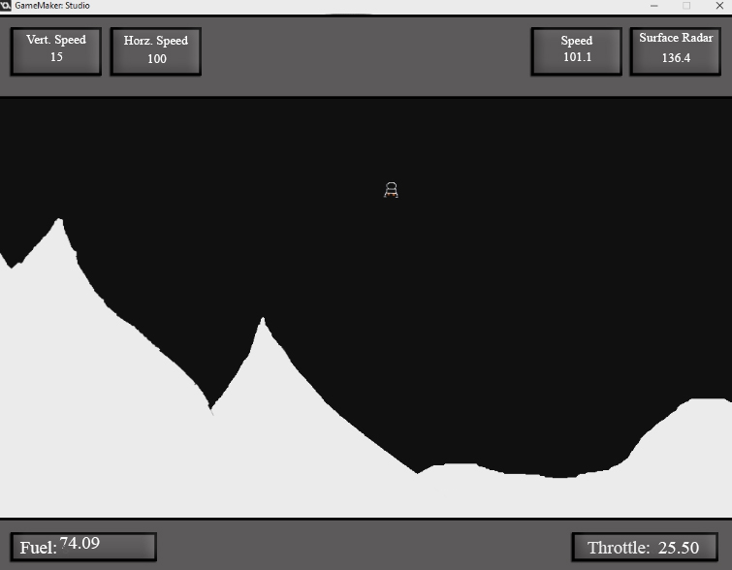
Advanced Game Design Final Project Slide # 4
H.U.D. Mock-up for Re-design
Labeled indicators
Each indicator is framed from each other and game world
Future ‘character’ models were made more defined and in some cases larger

